Slide 1
AIR QUALITY MONITORING
By,
U.S Muthu Chitra
K.Genga Parameswari
M.Siva jothi
K.Loga sakthi

Slide 2
CONTENTS
Introduction
Air Quality monitoring
Block diagram
Sensors
Op Amp
ARM Processor
zigbee
Threshold values
Advantages
Applications
Conclusion

Slide 3
INTRODUCTION
With fast development of industrialisation and urbanization pollution become more common.
Air pollution is presence of contaminants or pollutant substances that effect human health.
If we know the quantity of pollutant, then proper precautions can be taken to minimize the pollution levels in air.

Slide 4
AIR QUALITY MONITORING SYSTEM
One of the major application of wireless sensor network.
It is used for understanding the status of air pollution on the remote place.
It supports sensor data abstraction.

Slide 5
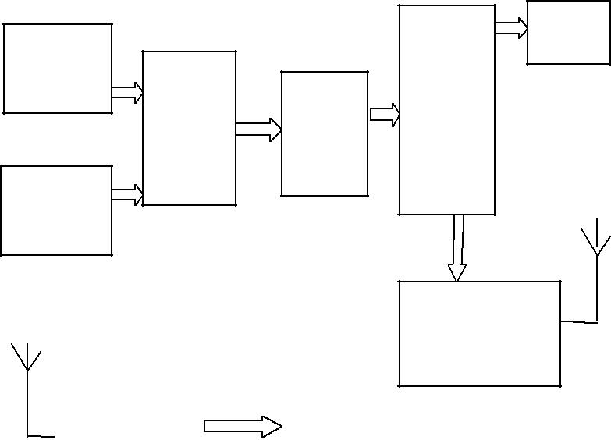
BLOCK DIAGRAM
LCD
CO2
Sensor
ARM 7
LPC
2148
OP
Amp
ADC
CO
Sensor
Zigbee
Transmitter
Zigbee
receiver
PC

Slide 6
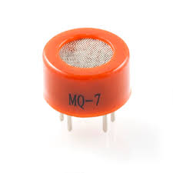
CO SENSOR
Detects the presence of carbon
monoxide in the air.
MQ-7 can detect CO gas from 20 to
2000 ppm.

Slide 7
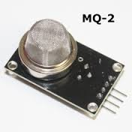
CO₂ SENSOR
Instrument used to measure carbon
dioxide gas.
Principles are infrared gas sensor
(NDIR) and chemical gas sensor.

Slide 8
OP AMP
ST OP Amps TSU10 series nano
amplifier ,TV711,TS731 high precision
op amps are used.
Their low supply voltage and ultra low
power consumption make them a
perfect for safety detectors operating in
toxic enironments.

Slide 9
THANK YOU

